Slide 1
A Predictive Tool for American Football Defensive Positioning to Aid Coaches in Design of Offensive Formations and Plays
Using Machine Learning and Sports Data Visualization
Alejandro Escobar
Faculty of Science, Department of Computer Science
CPSC 502
April 19, 2023

Slide 2
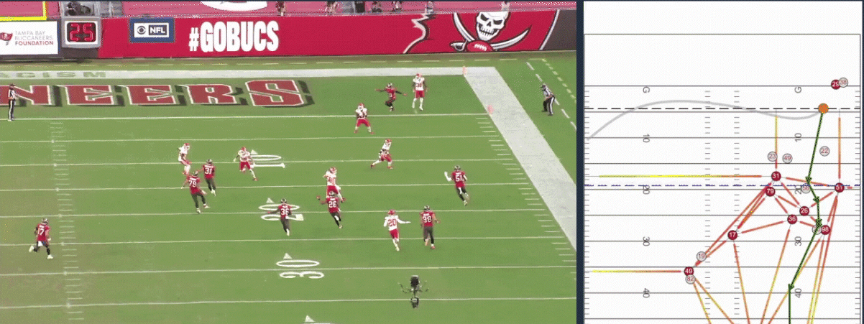
Background
National Football League (NFL)
American Football League in North America [1].
Big Data Bowl (2019 – Current)
Annual sports analytics competition hosted by the NFL [2].
Fourth annual Big Data Bowl champion project – Evaluation of punt returners in the NFL. (https://aws.amazon.com/nfl/aws-big-data-bowl-2022-winners/)
Notes:
First, we will begin with some background information to provide context to this project.
This project revolves around the sport of American Football.
The National Football League is a large American Football League in North America.
The NFL collects player tracking data from games in the regular NFL season and provides subsets of this dataset annually for the Big Data Bowl competition.
The Big Data Bowl is a competition that is hosted annually by the NFL, starting from 2019, that encourages students, researchers and other participants to develop solutions to a challenge every year.
For example, in the Fourth annual BDB Project, the winning team created a

Slide 3

Research Motivation/Goals
Produce a predictive model for defensive player trajectory.
Use player tracking data from the Big Data Bowl to generate sequences [2,3].
Train a Long Short-Term Memory model trained using sequence pairs.
Provide an interactive coaching tool through a Graphical User Interface (GUI) that integrates the model.
Allow users to interact and provide input to the underlying model.
Allow users to select from precomputed sequences of offensive players.
Notes:
Next, we will move on to the research motivation and goals.
Our first goal was to produce a predictive model for defensive player trajectory.
To do this we use player tracking data from the Big Data Bowl competition datasets to generate sequential data for offensive and defensive players.
Once we have these generated sequences in offensive/defensive pairs, we can train an LSTM model to predict full defensive sequences from offensive sequences and other user input which I will describe shortly.
Our second goal, and the overarching goal of this project, was to produce an interactive coaching tool that allows users to interact with the model seamlessly through a GUI.
This means that users will be able to see the predictive capabilities of the underlying model, and make positional adjustments of offensive and defensive players through the interface plot that will reflect on the predicted trajectory
We will also allow users to select from precomputed sequences of offensive players, meaning we will provide common/popular trajectories of wide receivers, allowing coaches to view a set of popular plays/routes

Slide 4
Related Work
Previous Big Data Bowl Submissions [2,4]
Several projects creating analytical or predictive models.
Ex: Evaluation of punt returners in the NFL [5].
Long Short-Term Memory (LSTM) Neural Networks
LSTM frameworks outperform alternatives for trajectory prediction [6].
Applications exist, such as basketball and vehicle trajectory prediction [7,8].
Sports Data Visualization
Projects involving visualization of tracking data in sports such as soccer and American football [9,10].
Notes:
Next, we will mention some of the related works of this project.
With the Big Data Bowl, there have been many projects
Long Short Term Memory neural networks are used in this project, some related works include
Reduce the related work, and if somebody inquires be sure to be able to elaborate on it

Slide 5
Methods
Data Preprocessing
Sequence Generation and Normalization
Offensive Sequence Clustering
Defensive Coverage Path Prediction
Graphical User Interface
Notes:
Add flow diagram for each section

Slide 6
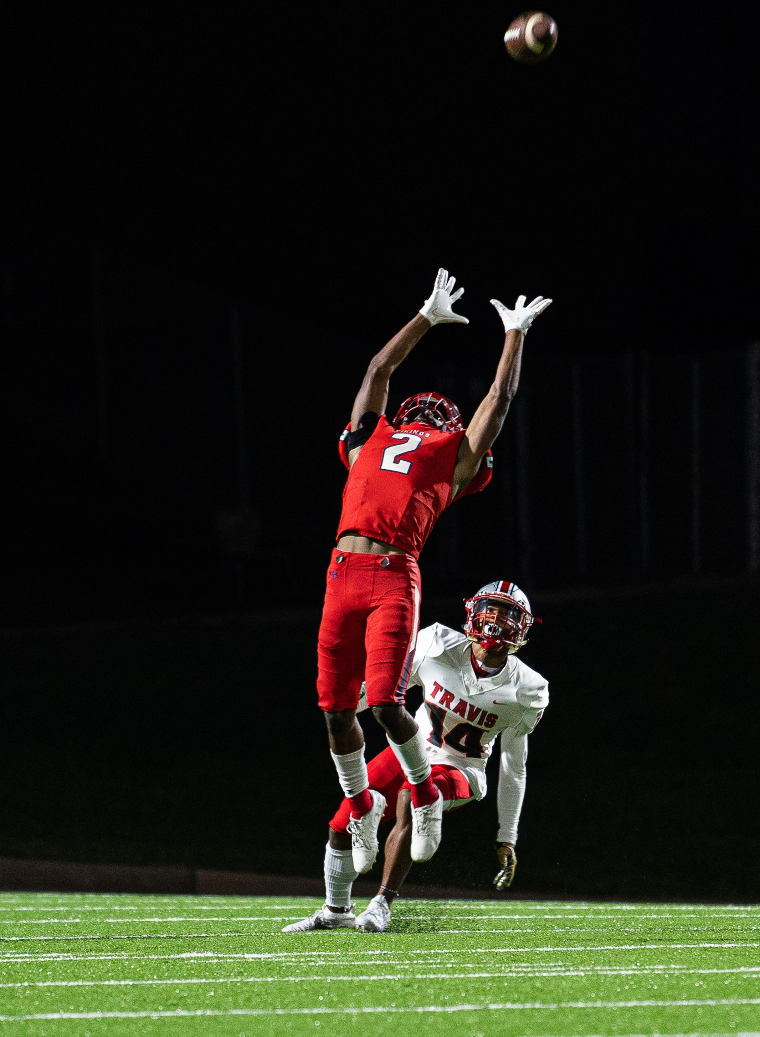
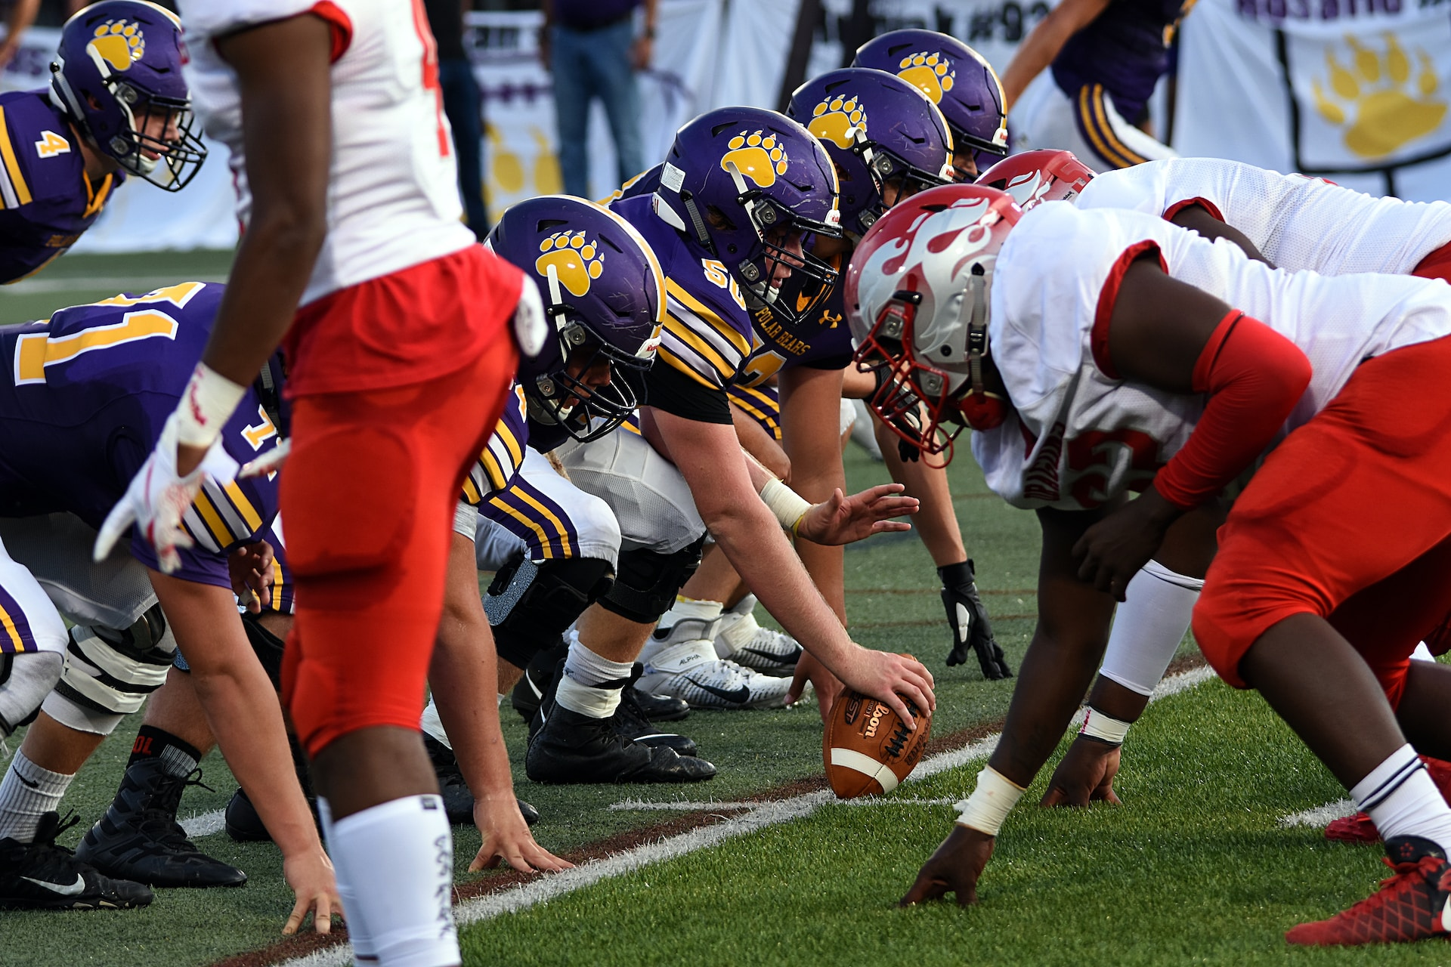
Data Preprocessing
We use data from the 2021 and 2023 Big Data Bowl datasets [12,13].
We clean/analyze the data to form assumptions for sequence generation.
Remove unused rows and columns.
Isolate defensive and offensive player positions.
Determine Initiating and Terminating events of a sequence.
Determine a cutoff of 10-90 frames per sequence.
Notes:
Reduce explicit details
Initiating Event: Ball Snap.
Offensive Player: Wide Receiver (WR).
Defensive Players: Strong Safety (SS), Free Safety (FS), Cornerback (CB).
Terminating Events: Fumble, Quarterback Sack, Lateral, etc.

Slide 7
Sequence Generation and Normalization
We proceed to generate sequences from the cleaned tabular data
We create sequences from all plays in the dataset in the format of a 2-Dimensional Tensor (Vector) for each player.
Then we isolate sequence pairs of offensive/defensive player pairs:
We encode additional features into each offensive sequence after pairing.
We normalize the x and y positions of both sequences (Next slide).
Inner Tensor Structure (All Predictors)
Notes:
Each inner tensor has the x, y and o (orientation) features of the tracking data.
Each inner tensor corresponds to one frame (1/10 of a second) in the play.
Encoded Features: line of scrimmage position, original starting x and y of the defensive player, and distance of the offensive player to both sidelines and targeted endzone.

Slide 8
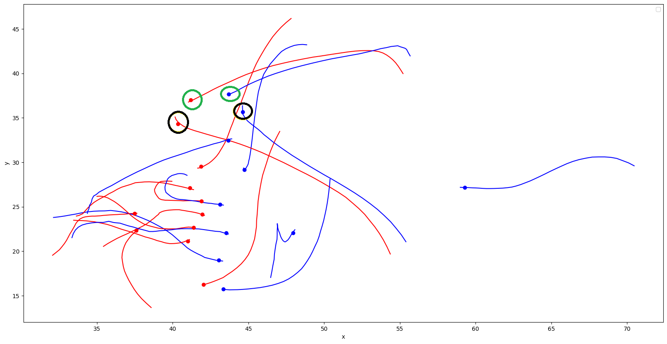
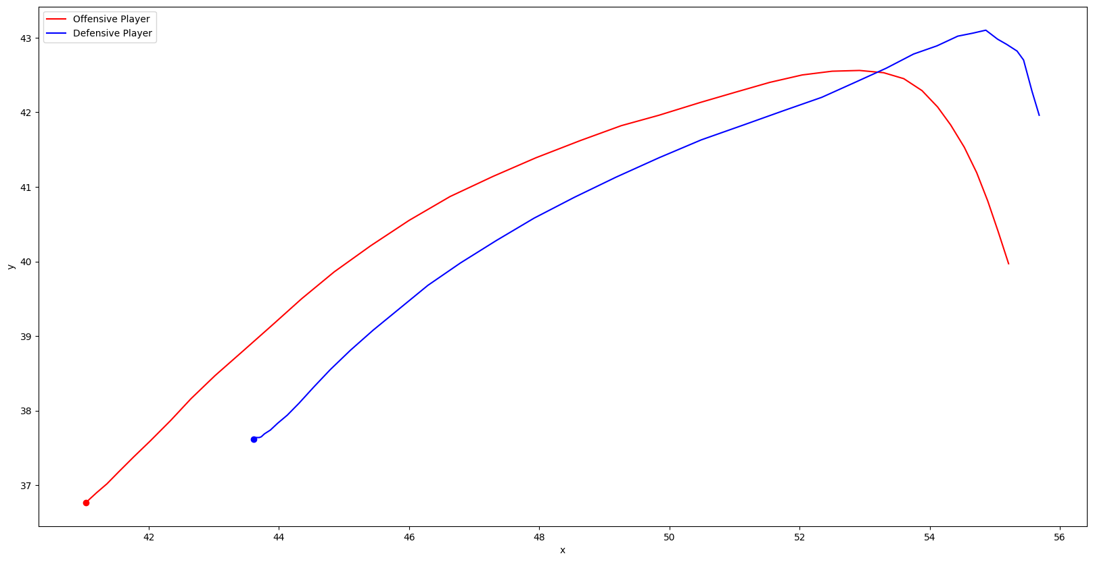
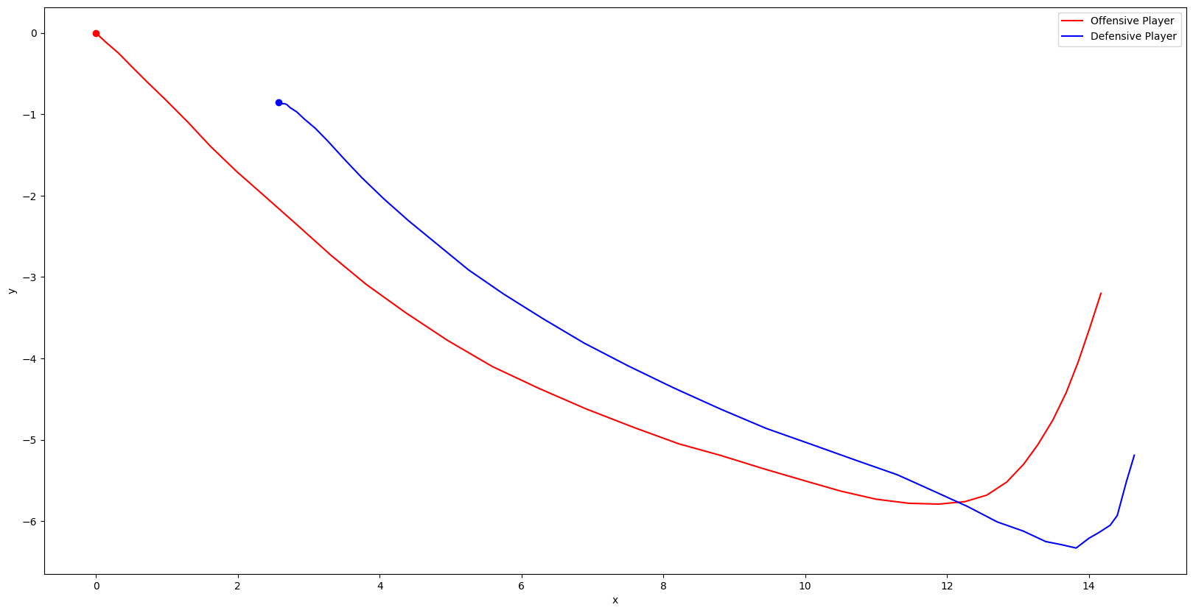
Sequence Generation and Normalization
Play Direction
Isolation
LOS
Normalization

Slide 9
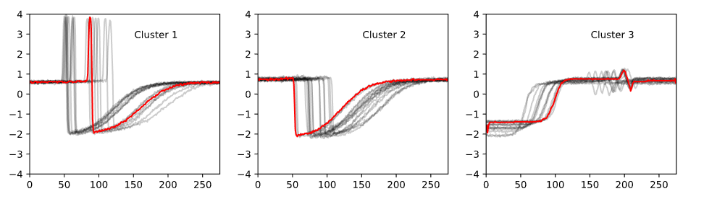
Offensive Sequence Clustering
We cluster all offensive sequences from the generated sequences:
Exclusively cluster based on the x and y features.
Compute 8 cluster centers in total.
The clustering is done using the Python tslearn library.
K-means clustering algorithm and a Dynamic Time Warping distance metric.
K-means DTW clustering example. (https://tslearn.readthedocs.io/en/stable/_images/kmeans_dtw.svg)
Notes:
Do not necessarily need all of the details
Minimizes the distance from cluster centers to other sequences in the dataset.
Required to compare the shapes of sequences with a different number of frames.
Idea: Shorter or longer sequences may have a comparable shape overall.

Slide 10
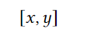
Defensive Coverage Path Prediction
We train an LSTM Model in TensorFlow 2 for Python using sequence pairs:
Define input as an offensive sequence, and output as a defensive sequence.
Model Architecture:
Batch Normalization Layer
Two LSTM Layers
Dropout Layers
We use the KerasTuner Python Library for Hyperparameter Tuning.
Input Inner Tensor (Offensive)
Output Inner Tensor (Defensive)
Notes:
We train an LSTM Model in TensorFlow 2 for Python using all sequence pairs with all previously defined features.
Split all sequences into training (70%) and testing (30%) datasets and organize these into batches of size 64 for training/evaluation.
Batch Normalization Layer: normalize all input features in each batch
Two LSTM Layers: identify sequence order dependence
Droupout Layers: Improve generalization of the model on test data.
Find optimal model hyperparameters using the Hyperband algorithm.

Slide 11
Graphical User Interface (GUI)
We develop the GUI of the coaching tool in Dash Open Source.
We developed the web application to support the following features:
Three Sequence Selection Modes:
Sequence Selection by Index.
Cluster Selection.
Play Selection.
Adjusting starting positions of both offensive and defensive players.
Visualization Features:
View full play and original player trajectories.
Adjust Line of Scrimmage (LOS).
Animate Play.
Notes:
Sequence Selection by Index: Select any of the ~ 13,000 generated sequence by index.
Cluster Selection: View a cluster center and select sequences closest to each center.
Play Selection: Select a game and play from the available dataset.
View full play and original player trajectories: Display other sequences in the play.
Adjust Line of Scrimmage (LOS): Move/simulate the play to a different location.
Animate Play: Display movement of sequences every 1/10 of a second.

Slide 12
Results

Slide 13
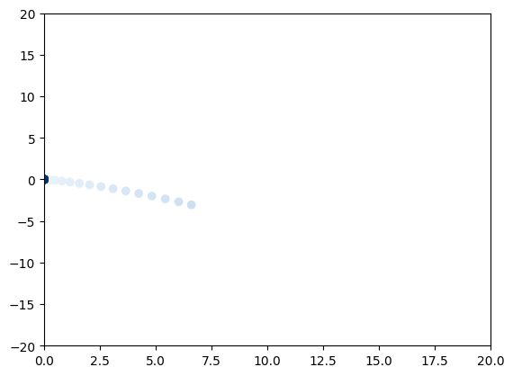
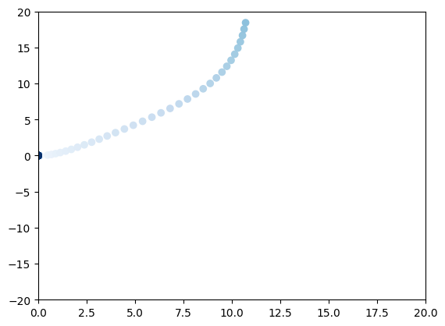
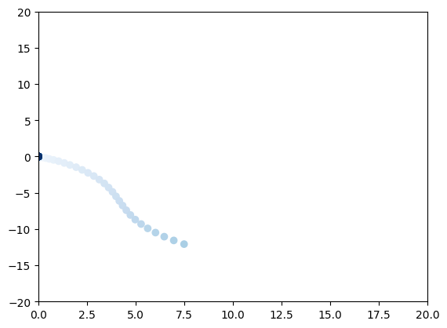
Offensive Sequence Clustering
We plot sequences closest to each cluster center to evaluate results.
Sequences closest to each center have similar shapes and lengths.
Clustering with different algorithms and distance metrics produced inconsistent results.
Cluster 1
Cluster 3
Cluster 5
Notes:
This implies the clustering was successful, and the cluster centers are acceptable for use.

Slide 14
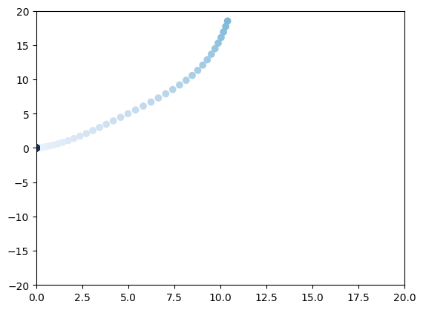
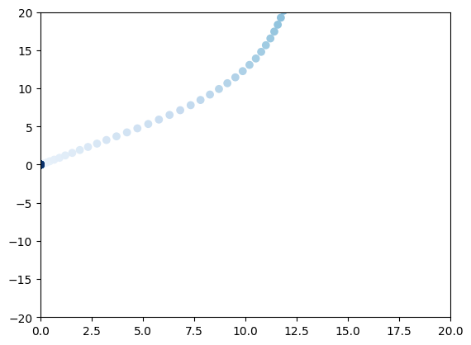
Offensive Sequence Clustering
Sequences Closest to Cluster 3

Slide 15
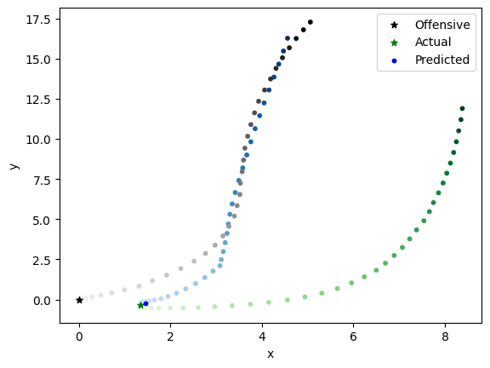
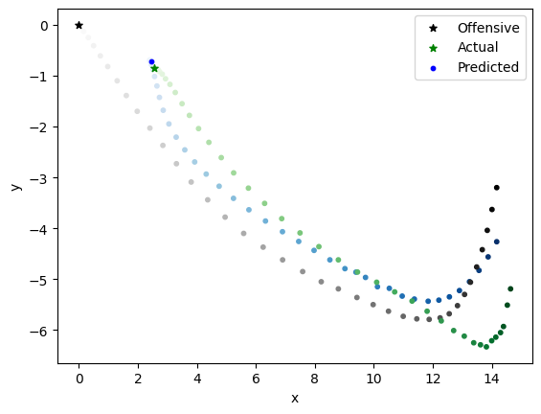
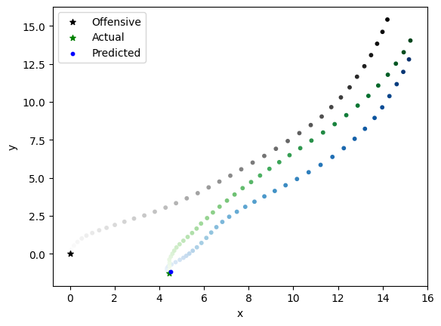
Defensive Coverage Path Prediction
We use the model which yielded the lowest MAE of 0.36845.
Predicted trajectories are typical of what a defender would run in a regular play.
Do not always want predicted trajectories to perfectly match the actual trajectory.
The model considers all input features in the prediction.
Notes:
Through a brief visual comparison predicted trajectories are typical of what a defender would run in a regular play.

Slide 16
Graphical User Interface (GUI)
All key features are implemented in the Dash application.
The GUI abstracts the use of the underlying model.
Users will interact through the interface and view visualizations of the predictive capabilities.
The GUI allows users to simulate real game scenarios using NFL data from the regular season.

Slide 17
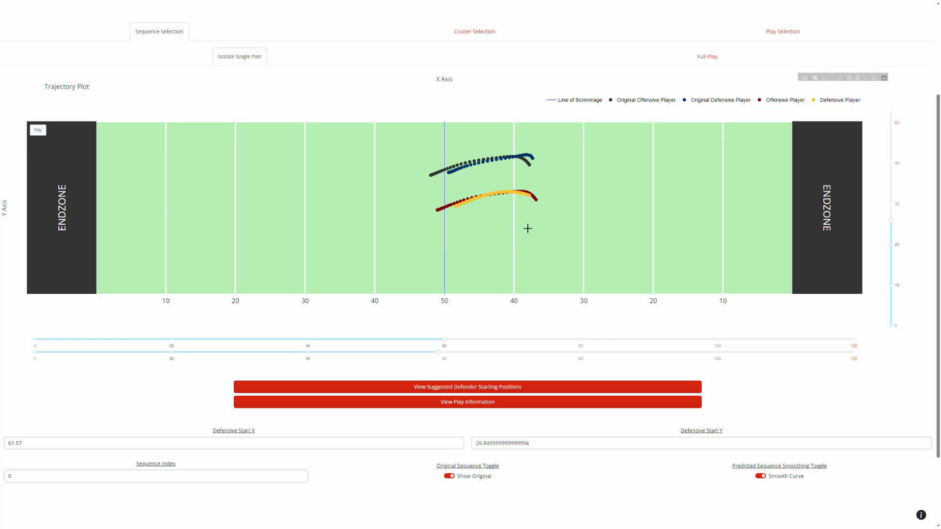
Graphical User Interface (GUI)
Notes:
Live commentary, and expand the videos out to the size of the slide

Slide 18
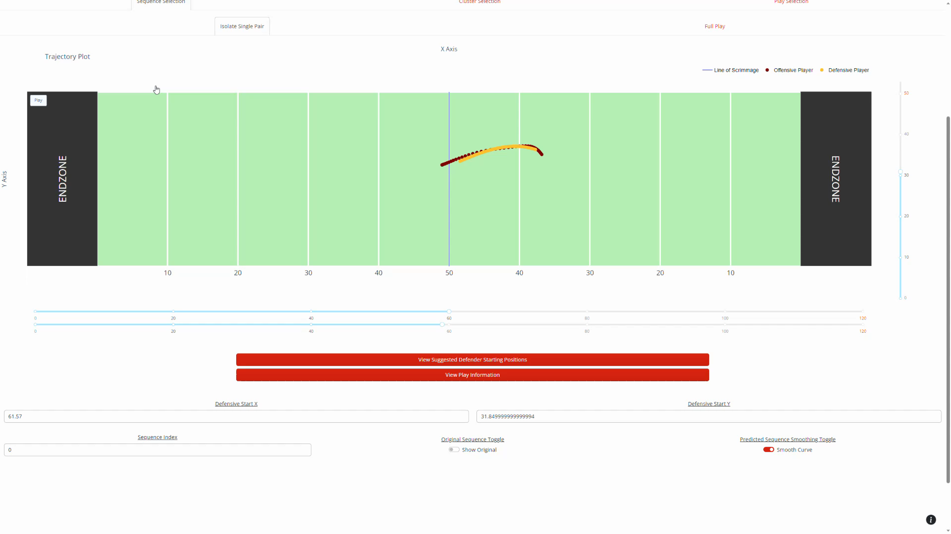
Graphical User Interface (GUI)

Slide 19
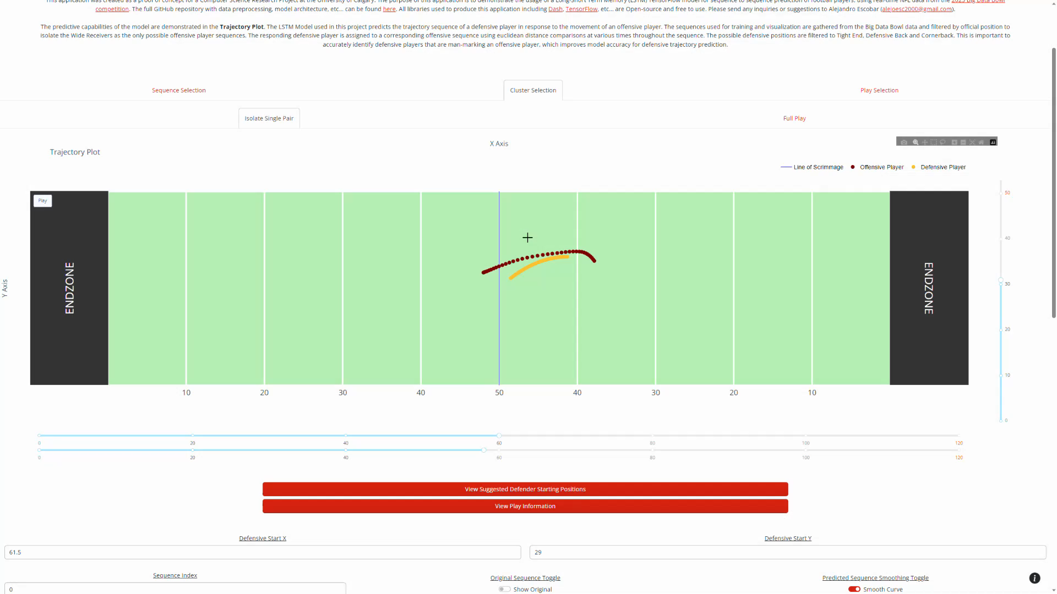
Graphical User Interface (GUI)

Slide 20
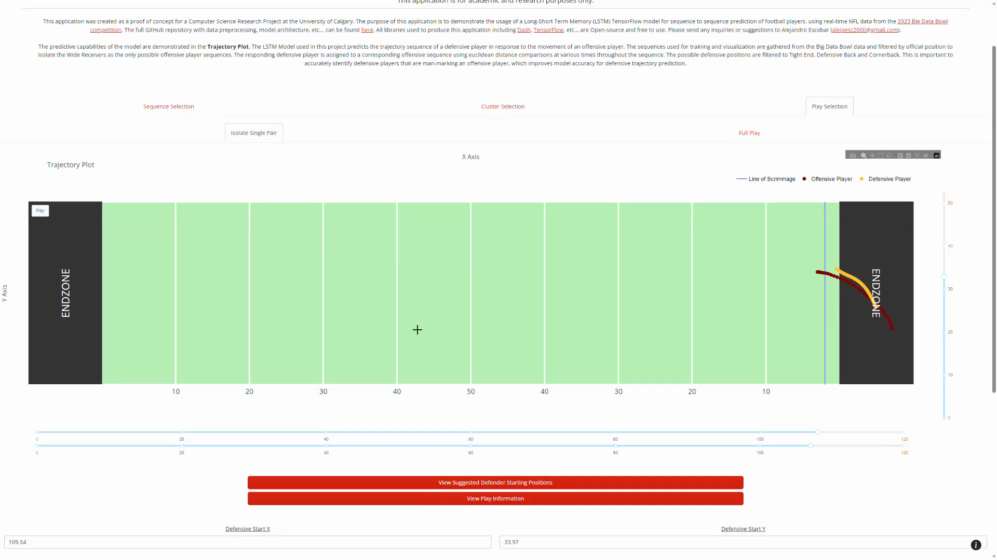
Graphical User Interface (GUI)

Slide 21
Discussion/Future Work
The components of this project have implications in the fields of sports analysis, machine learning and sports data visualization.
Key results and reproducible components:
Data processing.
Clustering.
Model Architecture.
Graphical User Interface.
Notes:
Extract points of each key component, and describe it verbally
- Researchers may replicate or expand on this with different decisions.
- This is especially important for future iterations of the project.
- The results in this project imply the popular trajectories of Wide Receivers in NFL games.
- With a different approach to sequence generation, the model can be expanded to support prediction of multiple defensive players.
- The configuration of a different model in this system is feasible.

Slide 22
Conclusion
The current results support the feasibility of a fully robust coaching tool that predicts trajectories of the entire defensive team.
The expansion of the model is the priority for this to be possible.
The current iteration of the coaching tool integrates the clustering results and LSTM model.
The LSTM model is responsive to user input and successfully abstracted.
Users can simulate real game scenarios with real NFL data.
The coaching tool is live at: cpsc502application.onrender.com

Slide 23
References
[1] The National Football League. 2022. Official Playing Rules of the National Football League. Retrieved April 17th, 2023 from https://operations.nfl.com/media/5kvgzyss/2022-nfl-rulebook-final.pdf
[2] The National Football League. 2023. NFL Big Data Bowl. Retrieved April 17th, 2023 from https://operations.nfl.com/gameday/analytics/big-data-bowl/
[3] The National Football League. 2023. NFL Next Gen Stats. Retrieved April 17th, 2023 from https://operations.nfl.com/gameday/technology/nfl-next-gen-stats/
[4] The National Football League. 2023. Past Big Data Bowl Recaps. Retrieved April 17th, 2023 from https://operations.nfl.com/gameday/analytics/big-data-bowl/past-big-data-bowl-recaps/
[5] Robyn Ritchie, Elijah Cavan, Brendan Kumagai, Ryker Moreau, Andrew Patton, Michael Lopez, and Thompson Bliss. 2022. Punt Returns: Using the Math to Find the Path. Retrieved April 17th, 2023 from https://www.kaggle.com/code/robynritchie/punt-returns-using-the-math-to-find-the-path/notebook
[6] Chujie Wang, Lin Ma, Rongpeng Li, Tariq S. Durrani, and Honggang Zhang. 2019. Exploring Trajectory Prediction Through Machine Learning Methods. IEEE Access 7 (2019), 101441–101452. https://doi.org/10.1109/ACCESS.2019.2929430
[7] Yu Zhao, Rennong Yang, Guillaume Chevalier, Rajiv C. Shah, and Rob Romijnders. 2018. Applying Deep Bidirectional LSTM and Mixture Density Network for Basketball Trajectory Prediction. Optik 158 (2018), 266–272. https://doi.org/10.1016/j.ijleo.2017.12.038
[8] Florent Altché and Arnaud de La Fortelle. 2017. An LSTM Network for Highway Trajectory Prediction. In 2017 IEEE 20th International Conference on Intelligent Transportation Systems (ITSC). 353–359. https://doi.org/10.1109/ITSC.2017.8317913
[9] Alina Bialkowski, Patrick Lucey, Peter Carr, Yisong Yue, Sridha Sridharan, and Iain Matthews. 2014. Large-Scale Analysis of Soccer Matches Using Spatiotemporal Tracking Data. In 2014 IEEE International Conference on Data Mining. 725–730. https://doi.org/10.1109/ICDM.2014.133
[10] Toshihiro Tani, H Huang, and Kyoji Kawagoe. 2015. Sports Play Visualization System for American Football. In Proceedings of the international multiconference of engineers and computer scientists, Vol. 1.
[11] The National Football League. 2021. NFL Big Data Bowl 2021. Retrieved April 17th, 2023 from https://www.kaggle.com/competitions/nfl-big-data-bowl-2021/data
[12] The National Football League. 2022. NFL Big Data Bowl 2023. Retrieved April 17th, 2023 from https://www.kaggle.com/competitions/nfl-big-data-bowl-2023/data

Slide 24
Thank you for your time!
Do you have any questions?
Alejandro Escobar
alejandro.escobar1@ucalgary.ca
Notes:
Endzone or sideline example (Extreme cases), to demonstrate any issues of the model
Clustering
Any additional GUI features, model limitations
Future work (how would you expand of the model)

Slide 25
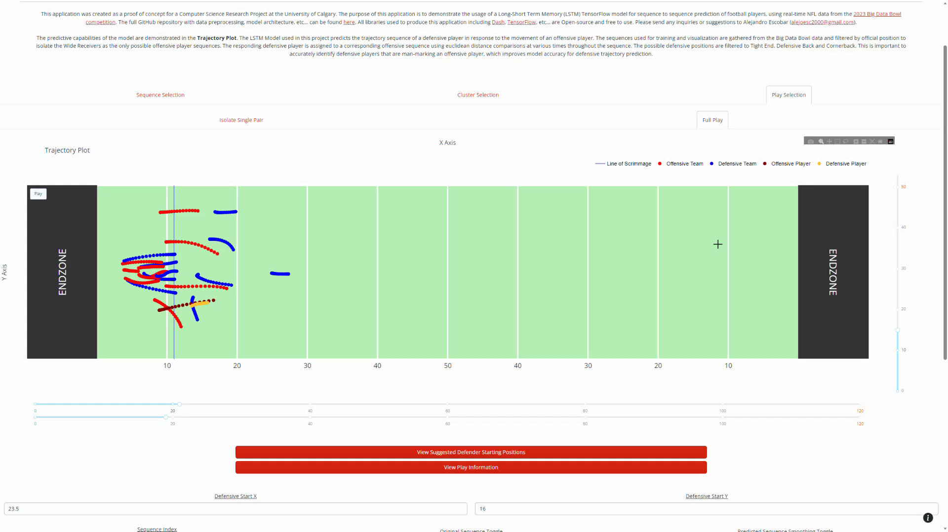
Graphical User Interface (GUI)
Notes:
Play and GUI information

Slide 26
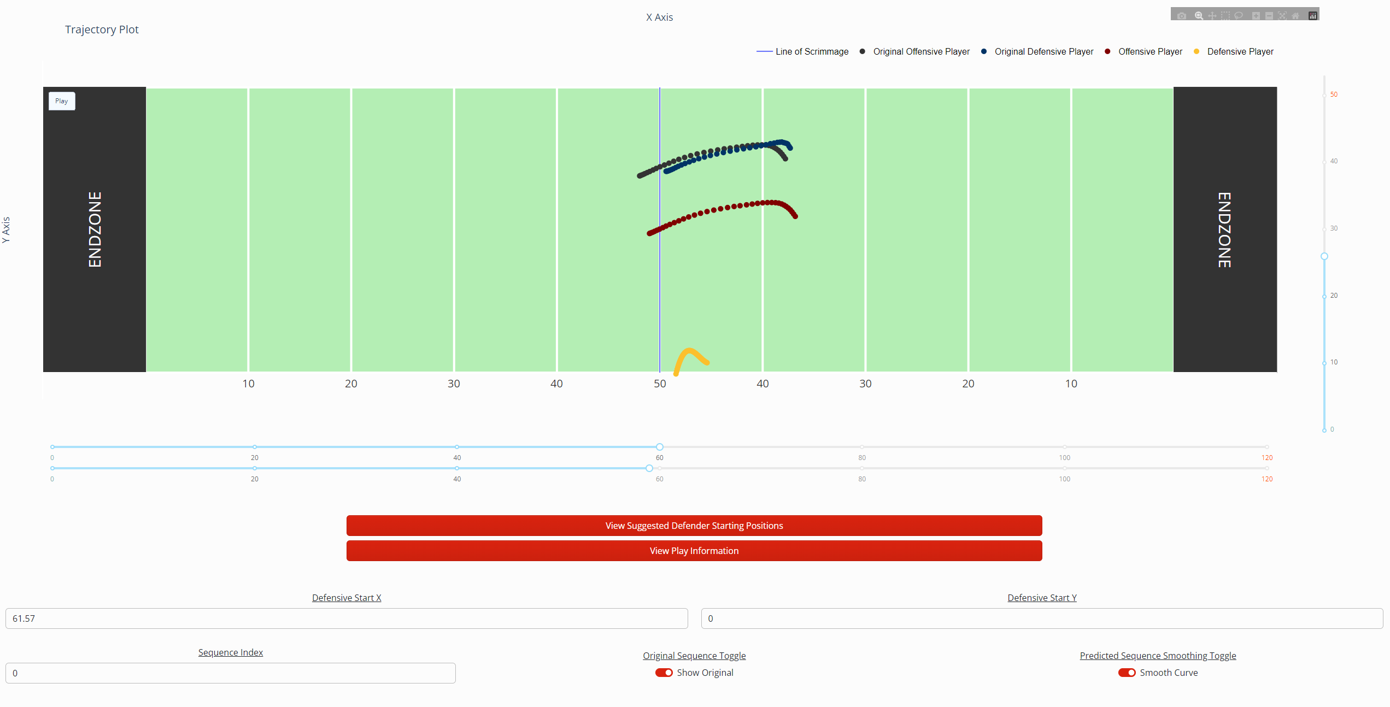
Extreme Use Case

Slide 27
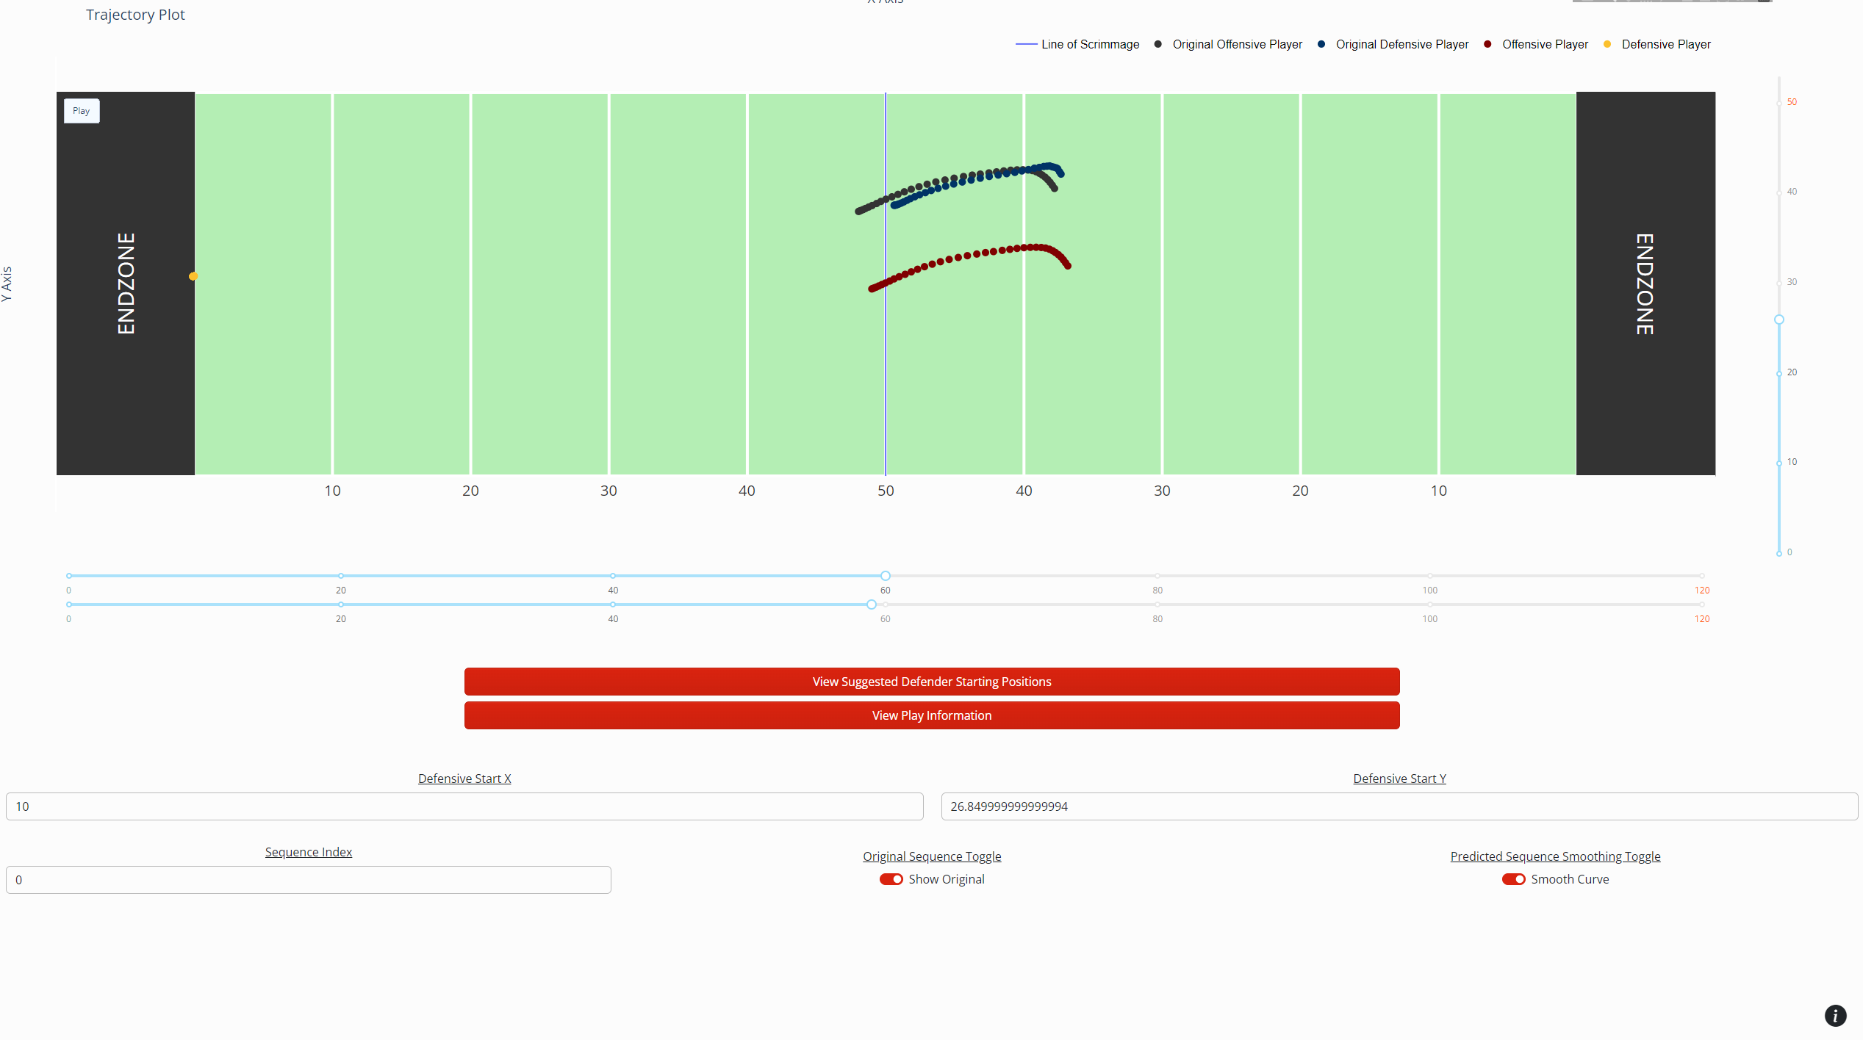
Extreme Use Case

Slide 28
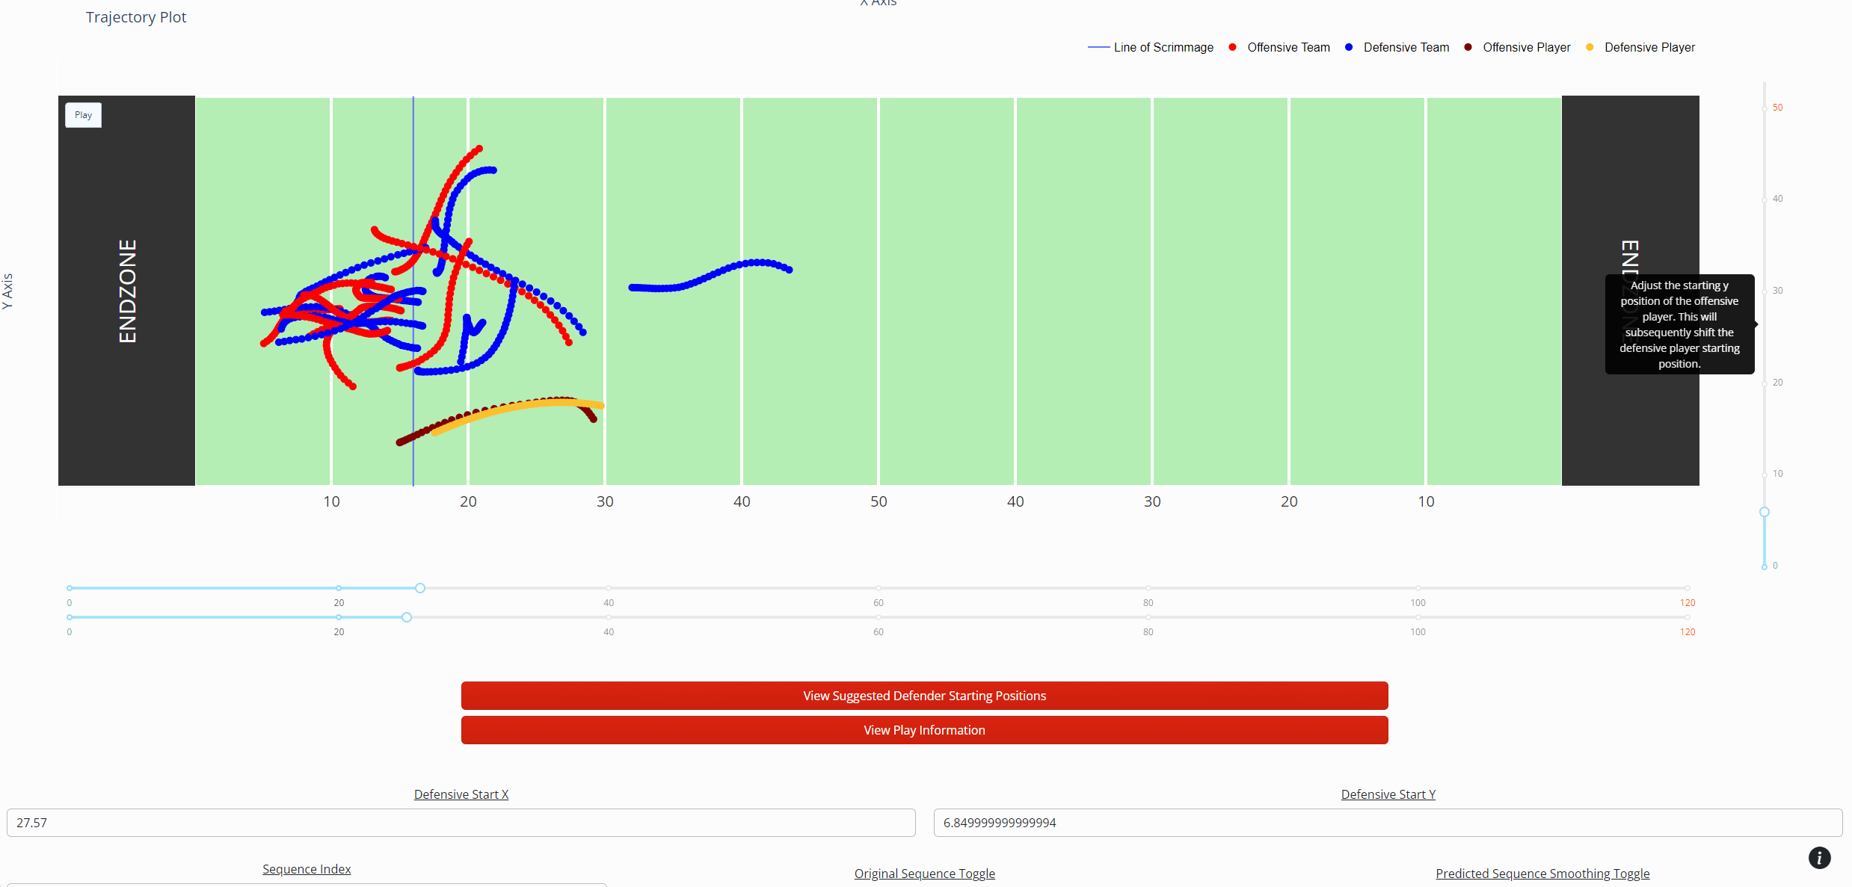
Adjusting Line of Scrimmage

Slide 29
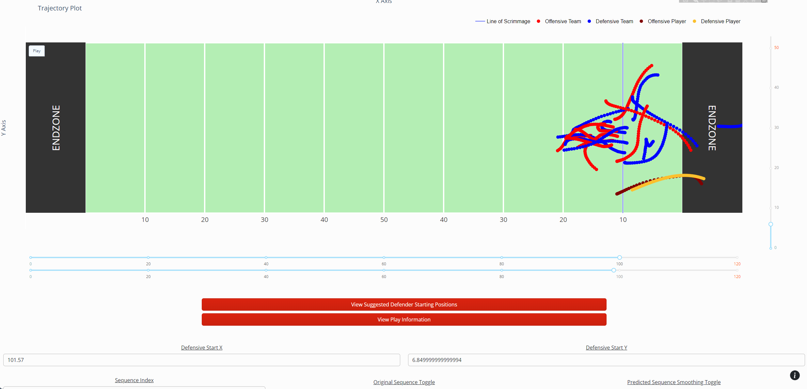
Adjusting Line of Scrimmage

Slide 30
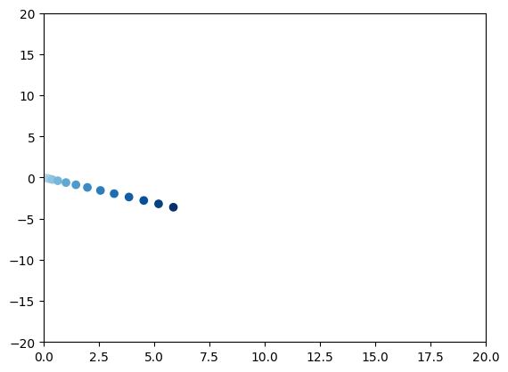
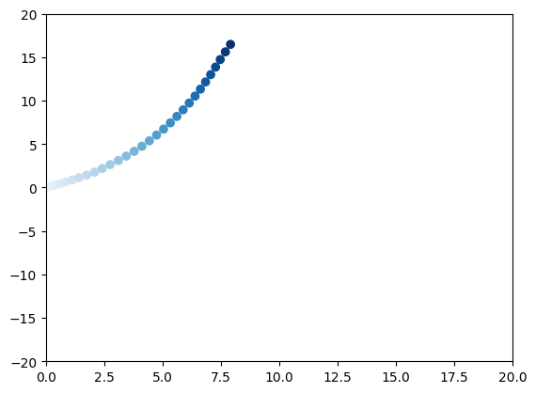
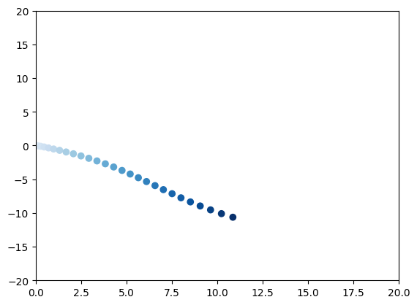
Clustering 2021/2023 VS 2021 Data
Cluster 4
Cluster 3
Cluster 5
2021/2023
Cluster 1
Cluster 3
Cluster 5
2023

Slide 31
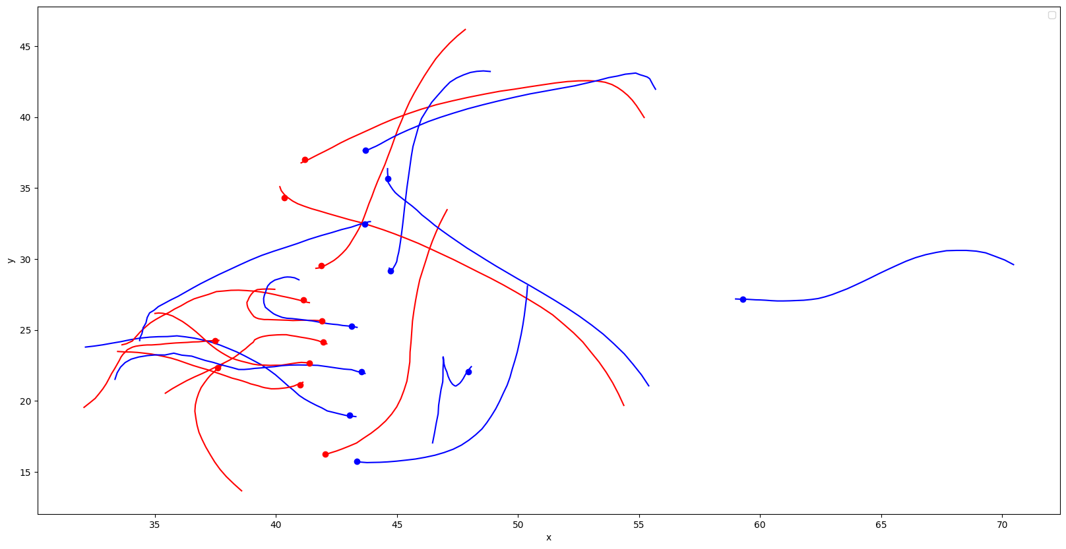
Model Expansions
Current iteration is limited to single defensive player prediction.
Project Expansion Key Steps:
Remove/Adjust positional filters.
Update offensive/defensive pairing.
Adjust model architecture.
Reconfigure GUI with new model.
Notes:
The current model does not consider other player sequences in single defensive player prediction either
The key steps of the model expansion would revolve around the way that offensive/defensive pairing is detected.
Our project suggests that single player prediction is feasible, and expansion is feasible, but this project focuses on Wide Receivers which are positions that can be quite easily isolated with a defender
Other positions may raise other challenges, and the matching problem is not trivial without descriptive information in the BDB dataset.

